Slide 1

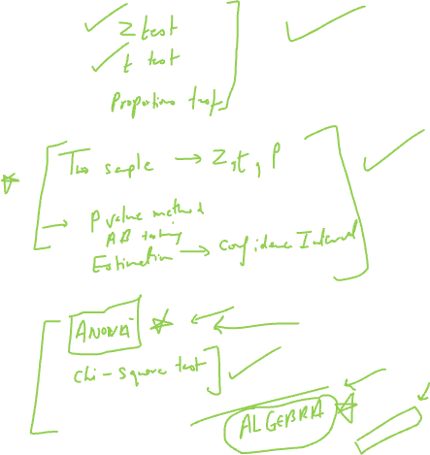
Single Sample Hypothesis Tests
By Amrita Panjwani

Slide 2

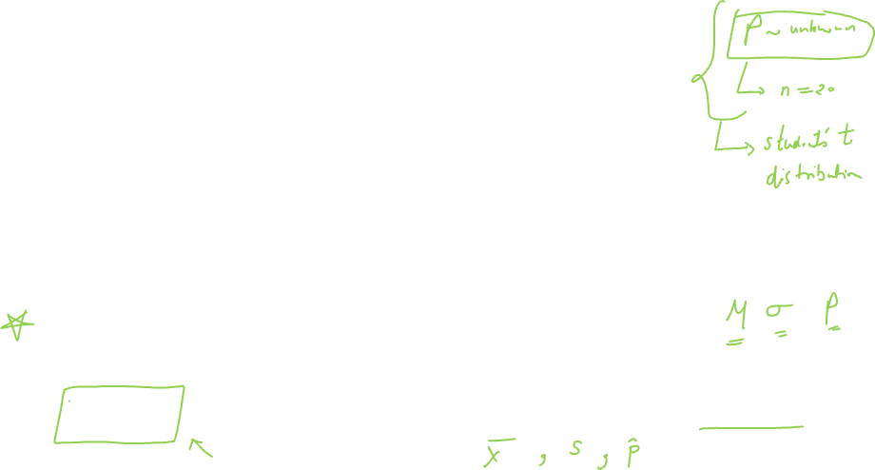
Basic terminology
Population: The complete set of objects on whom the research is based is called population
Sample: the selected few subjects from the population who become the part of the study is called sample
Parameter: characteristics of population are called parameter
Statistic: Characteristics of the sample are called statistic

Slide 3


Symbols used for Parameter and statistic
 | Parameter | Statistic
Mean | µ | x bar
Standard deviation | σ | s
Proportion | P | p^

Slide 4

Introduction of t distribution

Slide 5
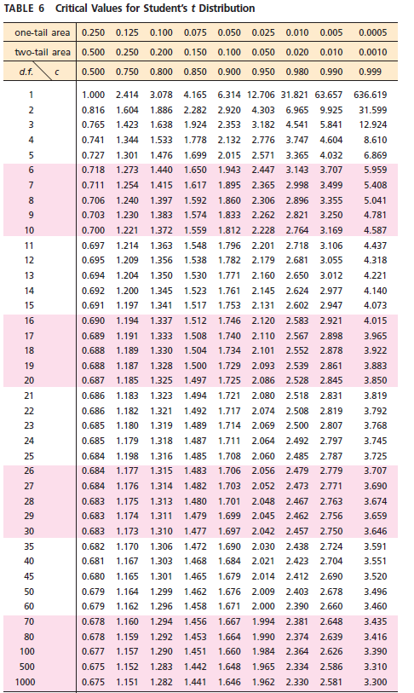
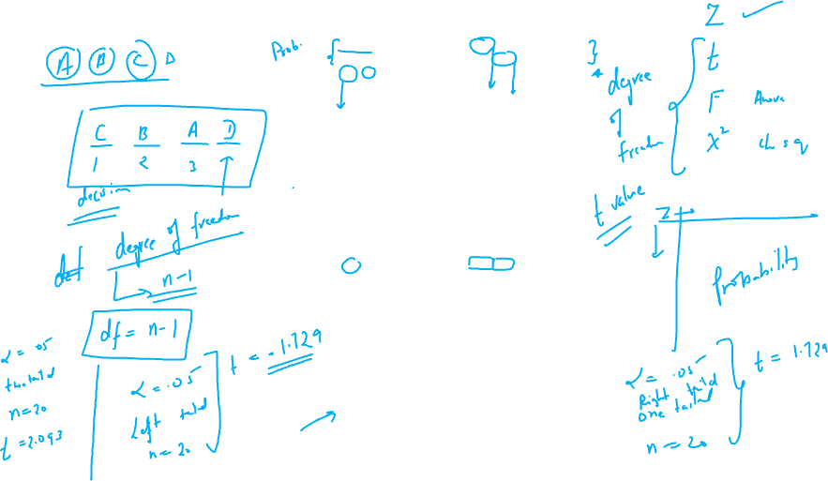

Slide 6

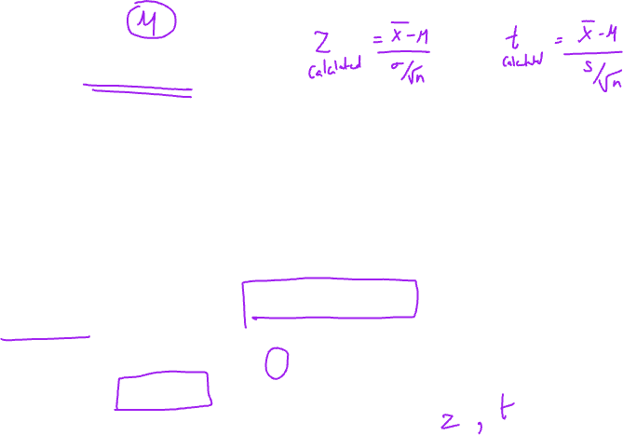
One Sample Mean test
When there is only one group or population under study, the hypothesis test employed for it is called a one sample hypothesis test
Based on the information provided in the question one decides whether to use Z test or T test
If population standard deviation σ is provided in the question One Sample Z Test applies
Else if sample standard deviation s is provided in the question One Sample T Test applies

Slide 7

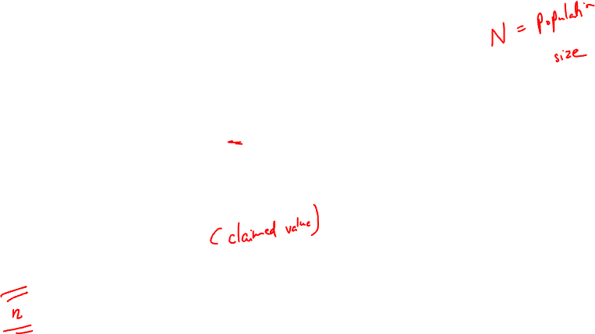
One Sample Z Test
Formula of Test Statistic Z
Z = ( xbar -µ ) / (σ / √n)
Where:
X bar = sample mean
µ = population mean
σ = population standard deviation
N = sample size

Slide 8

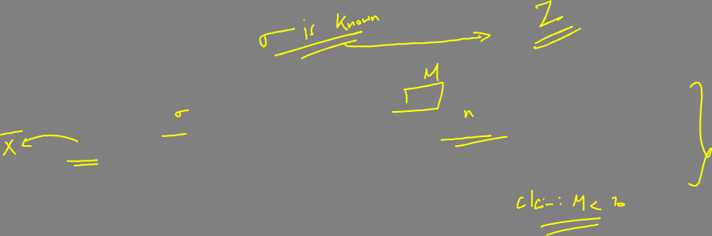
Example
The mean number of units produced is 70 with a population standard deviation of 5. The manufacturer samples 25 units with sample mean as 67. He claims that the average number of unites produced is less than 70. Test the claim of manufacturer at 5% level of significance.
First decide is it one sample Z test or T test ?
Since population standard deviation is provided it is a one sample Z test
Next you need to frame the correct set of hypothesis

Slide 9
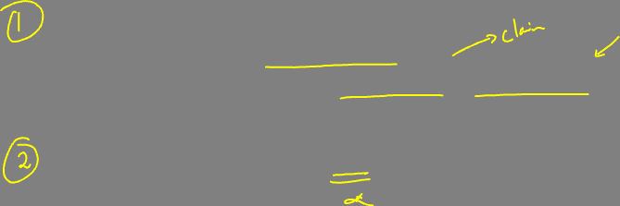
Key word: less than
Symbol : <
Hence the set of hypothesis:
Null hypothesis: Ho: µ ≥ 70
Alternate hypothesis: Ha: µ < 70 [ left tailed]
Level of significance = 5% [ provided in question]

Slide 10
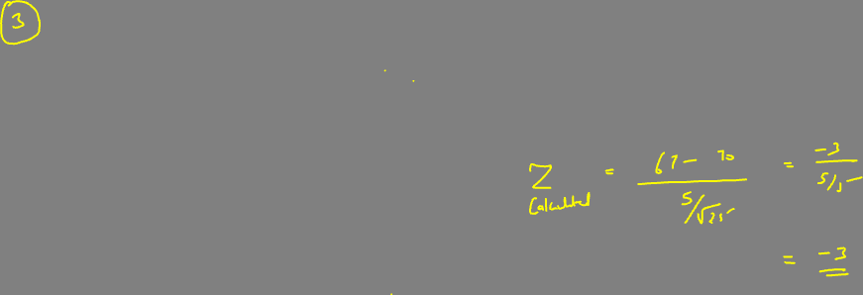
Test Statistic:
Z = ( xbar -µ ) / (σ / √n)
Values provided in the question are as follows:
µ = 70
σ = 5
Sample size n = 25
X bar = 67

Slide 11
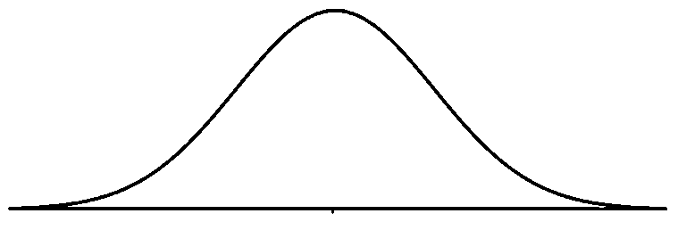
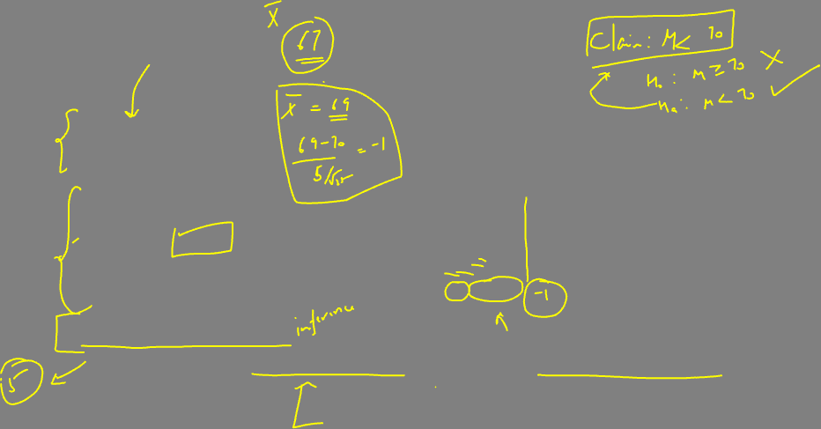
Plug in the values
Z = (67-70)/(5 / √25)
Z = -3
Step IV
Draw inference
Z critical = -1.645
Since Z statistic -3 < Z critical -1.645
Z statistic falls in rejection region
Decision: Reject the null
Conclusion: There is significant evidence to conclude that mean is less than 70
Rejection Region
Acceptance region
5%
-3
-1.645

Slide 12
One Sample T Test
Formula of Test Statistic T
t = ( xbar -µ ) / (s / √n)
Where:
X bar = sample mean
µ = population mean
s = sample standard deviation
n = sample size

Slide 13
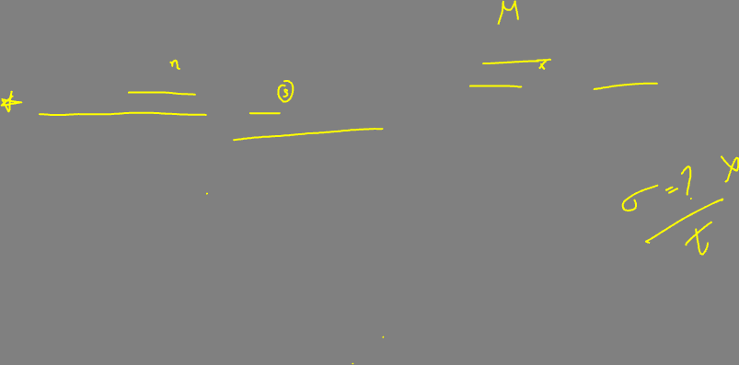
One sample T test
The mean number of units produced is 70. The manufacturer samples 25 units with sample mean as 67 and sample standard deviation 5.. He claims that the average number of units produced is less than 70. Test the claim of manufacturer at 5% level of significance.
First decide is it one sample Z test or T test ?
Since population standard deviation is NOT provided it is a one sample T test
Next you need to frame the correct set of hypothesis

Slide 14

Key word: less than
Symbol : <
Hence the set of hypothesis:
Null hypothesis: Ho: µ ≥ 70
Alternate hypothesis: Ha: µ < 70 [ left tailed]
Level of significance = 5% [ provided in question]

Slide 15
Test Statistic:
t = ( xbar -µ ) / (s / √n)
Values provided in the question are as follows:
µ = 70
s = 5
Sample size n = 25
X bar = 67

Slide 16
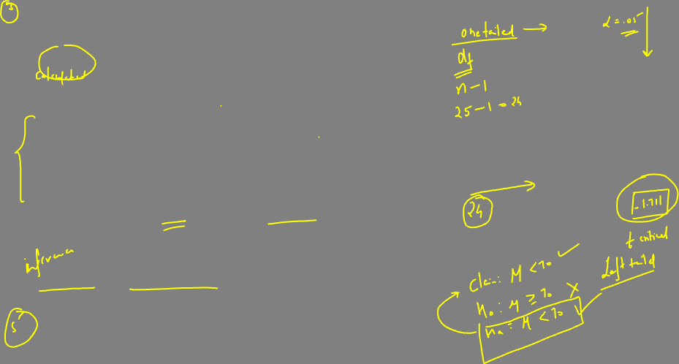
Plug in the values
t = (67-70)/(5 / √25)
t = -3
Step IV
Draw inference
Degree of freedom (df) = n – 1
Df = 25-1 = 24
t critical = -1.711
Since t statistic -3 < t critical -1.711
t statistic falls in rejection region
Decision: Reject the null
Conclusion: There is significant evidence to conclude that mean is less than 70
Rejection Region
Acceptance region
5%
-3
-1.711

Slide 17
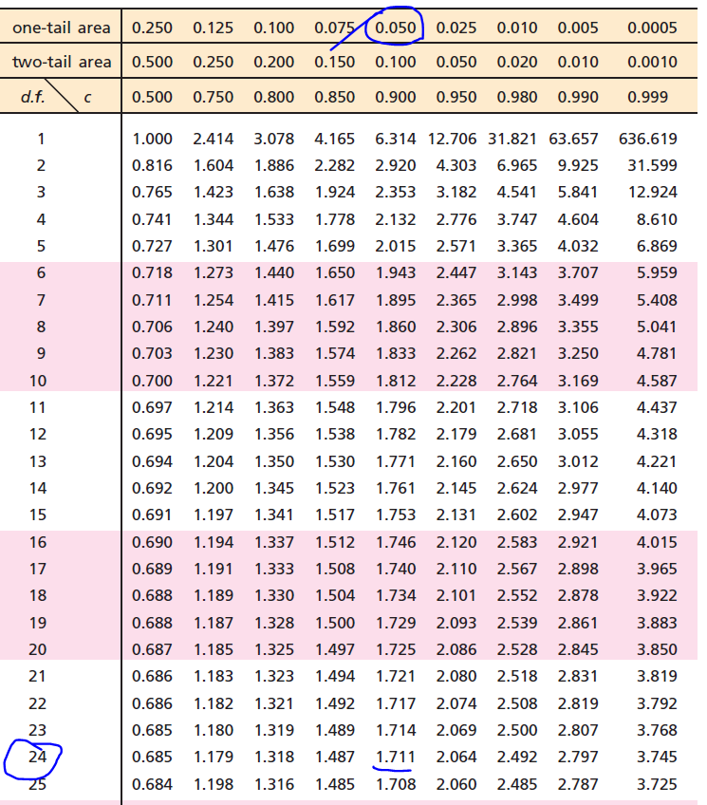

Slide 18
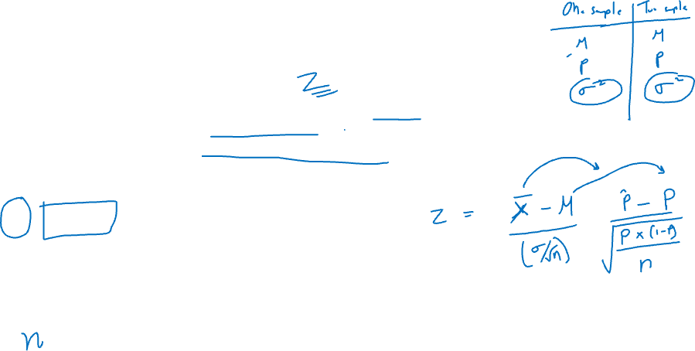
One sample proportion test
When the data does not relate to the mean value of the population, but the proportion of population, the researcher makes use of one sample proportion test
Test Statistic used for one sample proportion test:
Z = (p^ - P) / √(P*(1-P)/n)
Where:
P^ = sample proportion
P = Population proportion
N = sample size

Slide 19
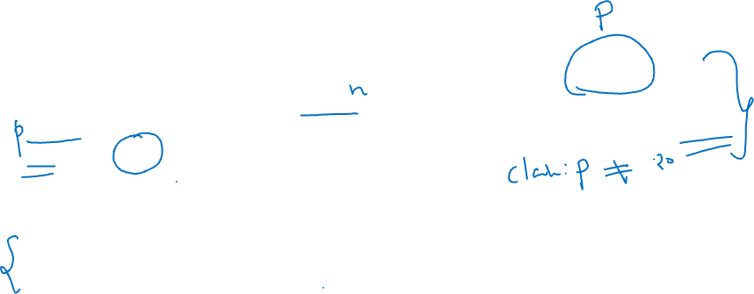
Example
The defective rate stated by the manufacturer is 20%. The manufacturer samples 25 units and gets a defective rate of 15%. Test the claim of manufacturer that defective rate is not 20% at 5% level of significance.
First decide is it one sample Z test or T test ?
Since population proportion is provided it is a one sample Z test
Next you need to frame the correct set of hypothesis

Slide 20

Key word: Not equal to
Symbol : ≠
Hence the set of hypothesis:
Null hypothesis: Ho: P = 0.20
Alternate hypothesis: Ha: P ≠ 0.20 [ two tailed]
Level of significance = 5% [ provided in question]

Slide 21
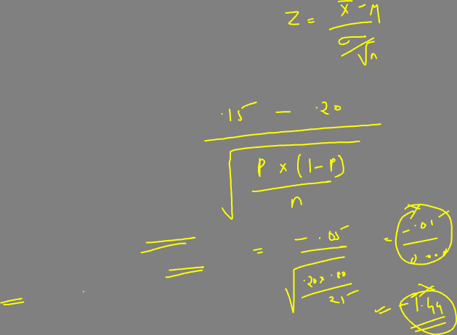
Test statistic to be used:
Z = (p^ - P) / √(P*(1-P)/n)
Where:
Sample proportion = P^ = 15% or 0.15
Population proportion = P = 20% or 0.20
Sample size = n = 25

Slide 22
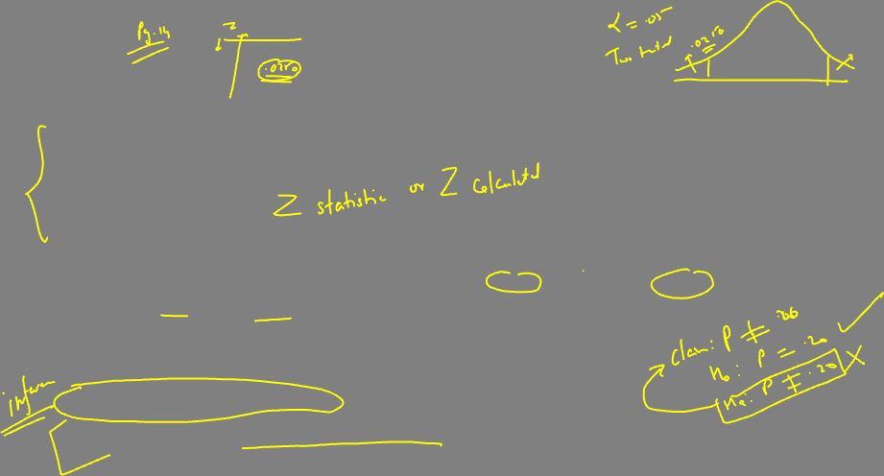
Plug in the values
Z = (0.15-0.20)/ √(0.2*0.8 / √25)
Z = -0.625
Step IV
Draw inference
Z critical = -1.96 and +1.96 [ two tailed]
Since Z statistic |z| = |-0.625| = 0.625 < Z critical 1.96
Z statistic falls in Acceptance region
Decision: Fail to reject the null
Conclusion: There is NO significant evidence to conclude that proportion is different than 20%
Rejection Region
Acceptance region
Rejection Region
2.5%
2.5%
-1.96
-0.625
+1.96

